Slide 1

Malignant Comment Classification Project
Submitted By:
YATENDRA JHA

Slide 2
Introduction
In the past few years, the cases related to social media hatred have increased exponentially. Social media is turning into a venomous pit for people.
The proliferation of social media enables people to express their opinions online but, at the same time, this has resulted in the emergence of conflict and making online environments uninviting for users.
The increase in cyber bullying cases can affect anyone mentally leading to depression, mental illness, self-hatred and suicidal thoughts.
Our goal here is to build a classification model using NLP techniques to classify comments as good/neutral or negative comments.

Slide 3
Data Set Description
Training dataset has 159000 samples and Test dataset has 153000 samples.
The data set includes:
Malignant: It is the Label column, which includes values 0 and 1, denoting if the comment is malignant or not.
Highly Malignant: It denotes comments that are highly malignant and hurtful.
Rude: It denotes comments that are very rude and offensive.
Threat: It contains indication of the comments that are giving any threat to someone.
Abuse: It is for comments that are abusive in nature.
Loathe: It describes the comments which are hateful and loathing in nature.
ID:It includes unique Ids associated with each comment text given.
Comment text: This column contains the comments extracted from various social media platforms.

Slide 4
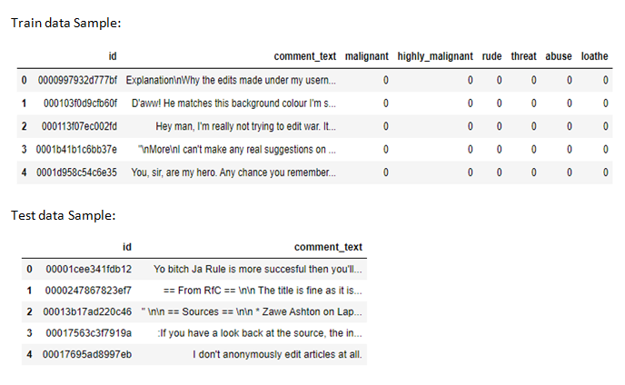

Slide 5
From the label counts and label distribution over comments we observe imbalanced data and among the negative comments least number of comments are classified as threat whereas, more number of comments are classified as malignant.
Percentage of good/neutral comments = 89.83%
Percentage of negative comments = 10.16%
Since there are 6 independent features whose value is to be predicted so we will introduce a new column in dataset as ‘label’ which indicates ‘1’ for good/neutral comments and ‘0’ for negative comments.

Slide 6
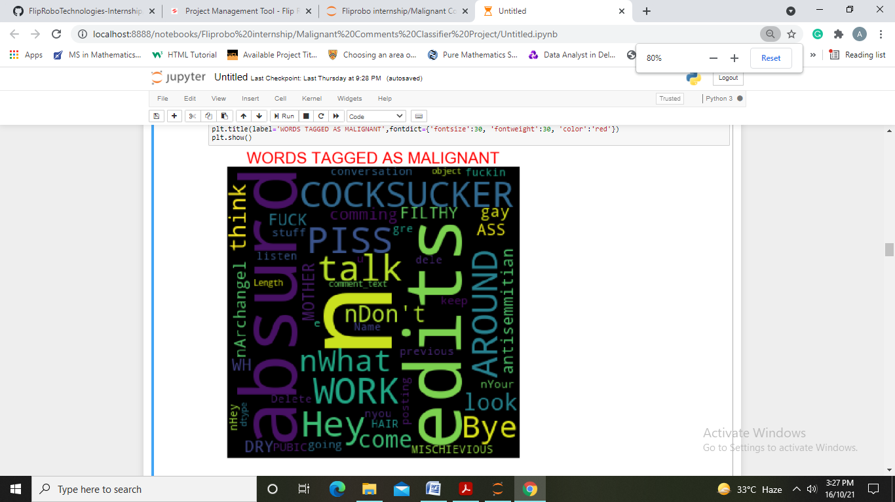
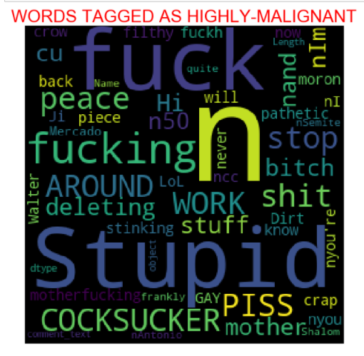
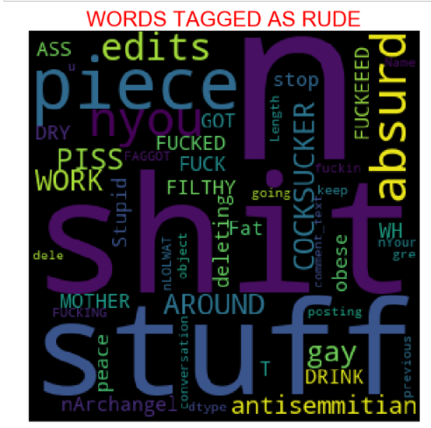
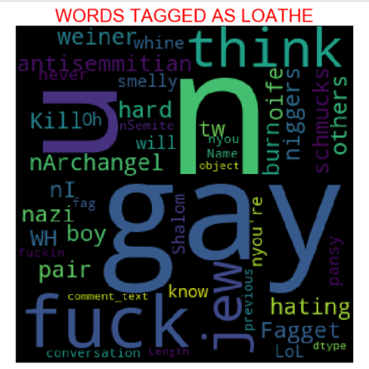
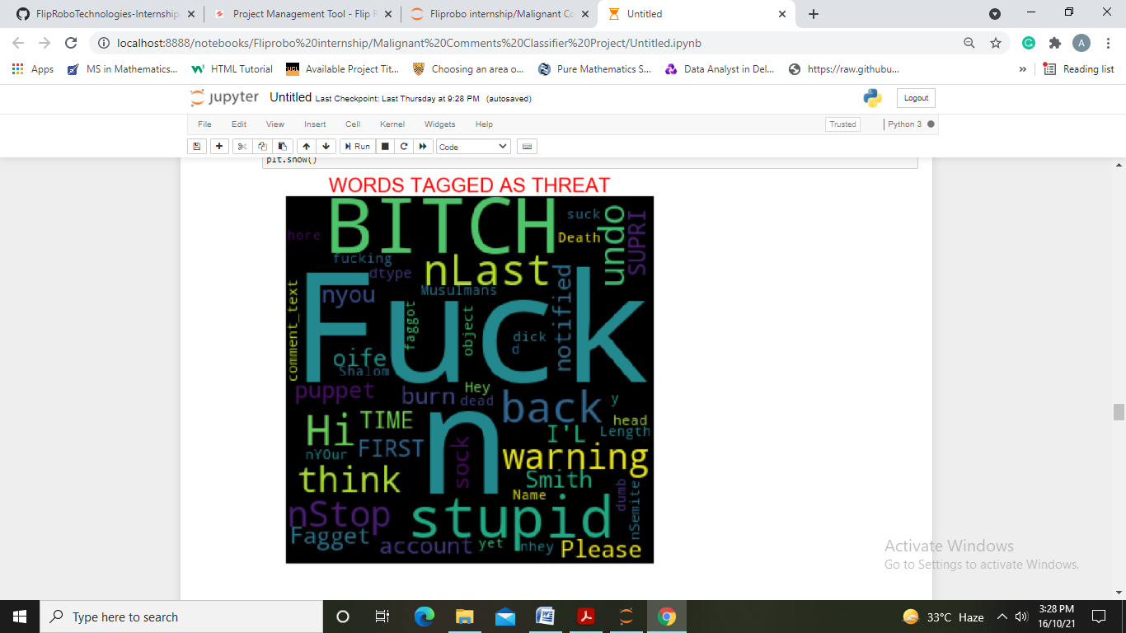
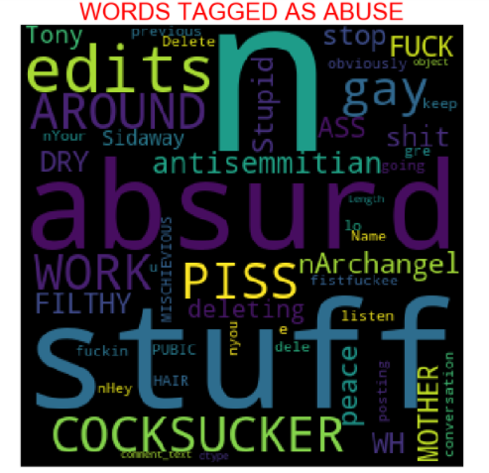
We have also observed most frequent words in positive and negative comments through word-cloud

Slide 7
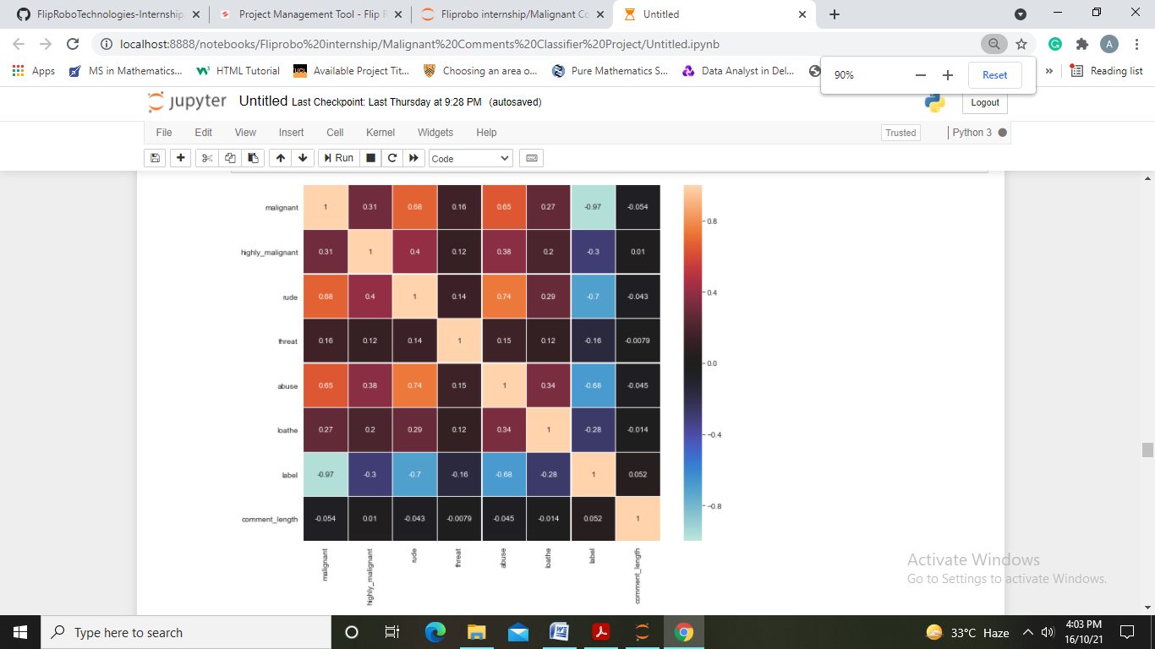
Finding relations with help of correlation
We make following conclusions:
Highest correlation is observed between ‘rude’ and ‘abuse’.
Correlation observed here is both positive and negative

Slide 8
Data Pre-Processing
We have used data cleaning steps involved in NLP and modified data which is not in proper format.
First step is to remove unnecessary features like ’id’.
Next we have made a function to filter using POS tagging.
Created another function named “Clean_data” which involves :
Removing ‘\n’ or extra lines.
Removing numbers, HTML tags, websites, unwanted white spaces, etc.
Transforming text into lower case.
Removing remaining small and irrelevant tokens.
Lemmatizing words using WordsNetLemmatizer().
We can see the functions used in next slide.

Slide 9
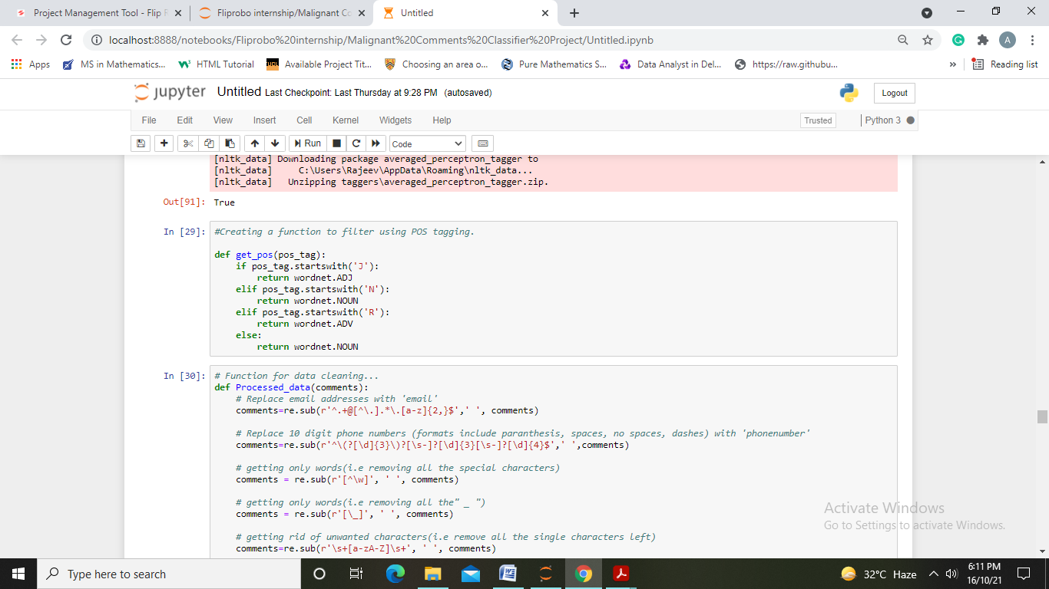
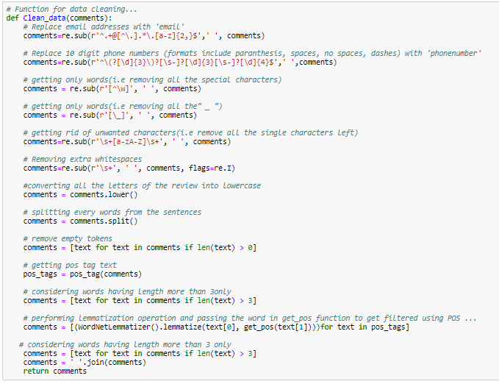

Slide 10
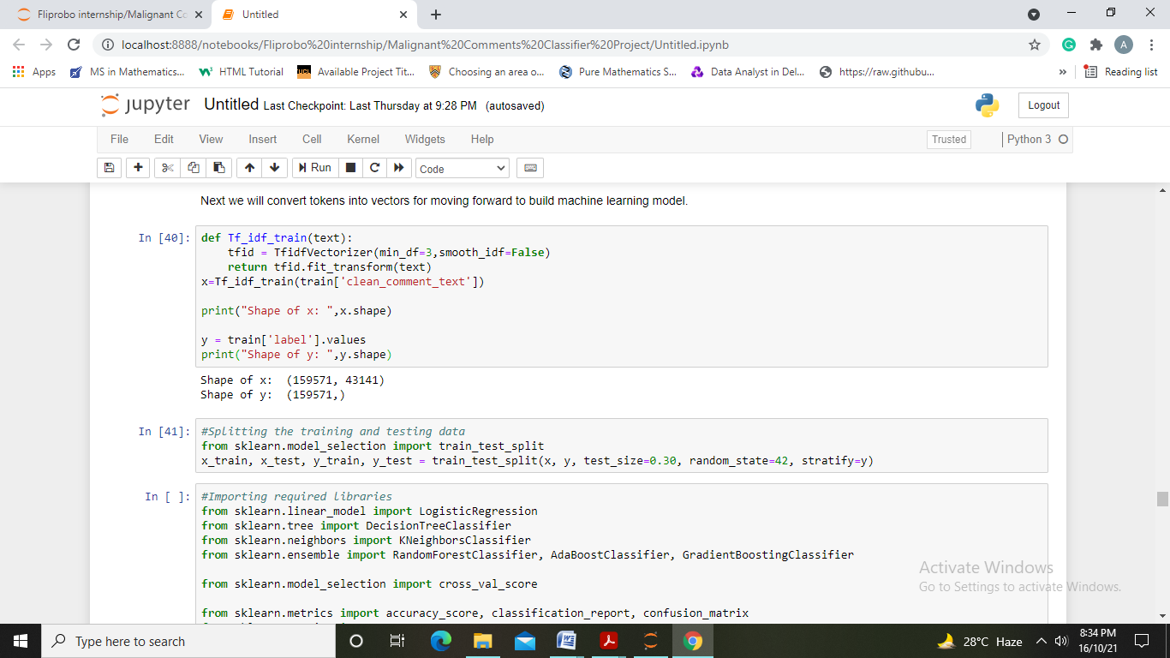
Preparing Data for Model
We have first separated data and then converted it to number features using TfidVectorizer. Further split our data into train and test part.

Slide 11
Model Building and Evaluation
Algorithms used are:
Logistic Regression
Decision Tree Classifier
KNeighbors Classifier
Random Forest Classifier
Gradient Boosting Classifier
AdaBoostClassifier

Slide 12
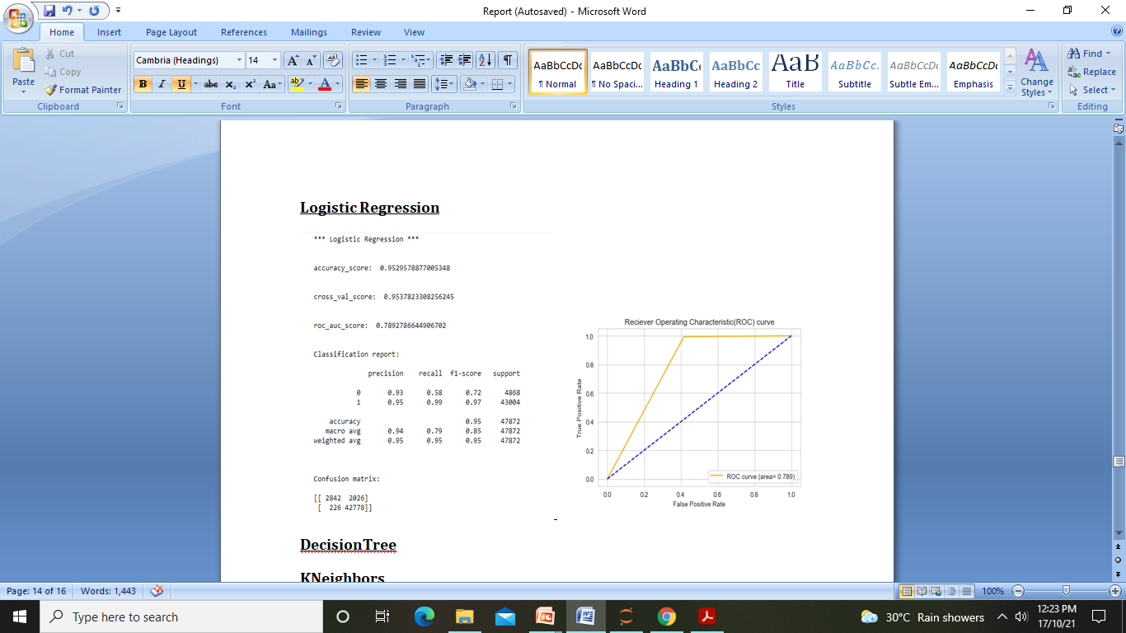

Slide 13
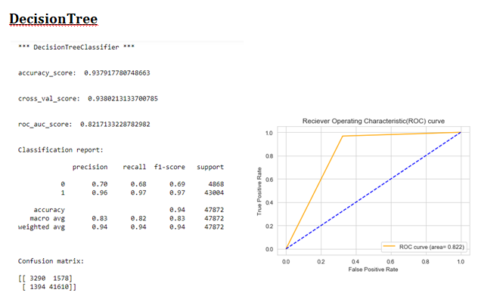

Slide 14
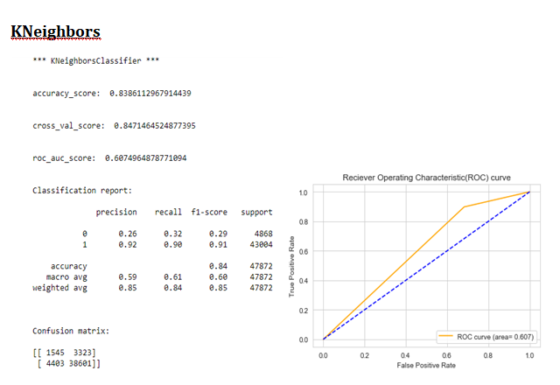

Slide 15


Slide 16
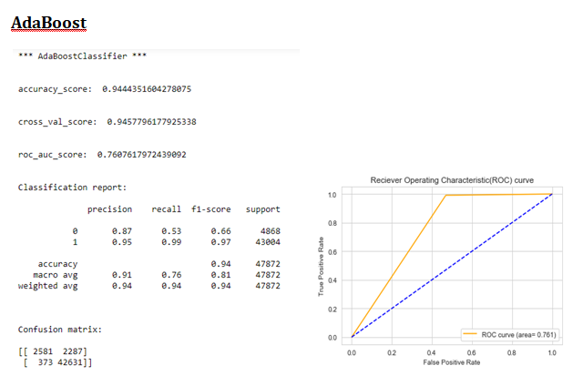

Slide 17
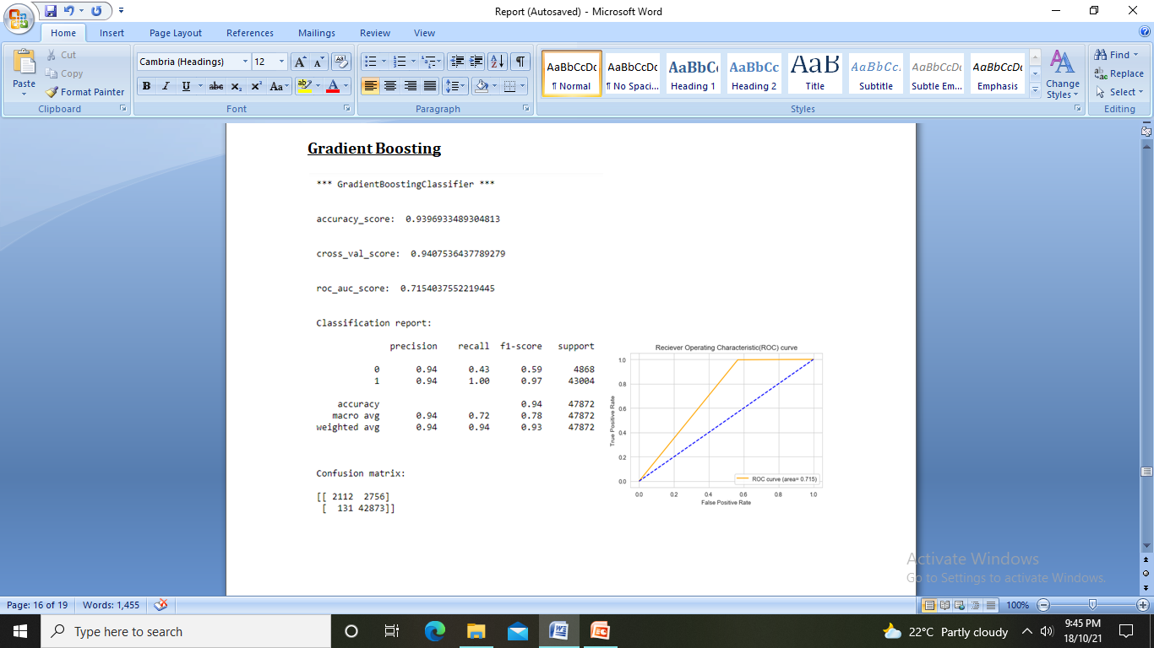

Slide 18
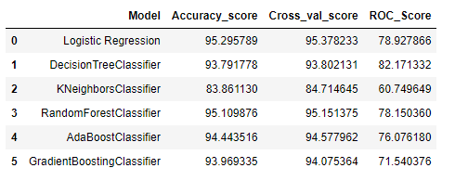
Data Frame below shows the algorithms used and the accuracy scores, CV scores and ROC score obtained
By looking at various metrics we will choose Decision Tree Classifier as our best model and finalize it.

Slide 19
Prediction using test data:
First we will perform all the pre-processing steps performed on train dataset and use vectorizer to convert comments to vectors.
Predict the values using selected model and save it to a csv file.

Slide 20
Conclusions
KEY FINDINGS AND CONCLUSIONS OF THE STUDY
We have first loaded both test and train dataset and looked into it to check for null values, data types, dropping unnecessary columns,etc.
Exploratory Data Analysis is performed using visualizations to gain insights. We observe more of comments classified as malignant comments.
We have used NLP to pre-process and clean data. Since we had 6 labels to be predicted we introduced a new column ‘label’ which shows ‘1’ for good/neutral comments and ‘0’ for negative comments.
We have used Vectorizer to convert comment tokens to numeric form.
After considering the mentioned algorithms we concluded Decision Tree Model to be best model which gave an accuracy of 95.2%.
We further used the model selected to predict ‘label’ for test dataset and saved it in csv file.

Slide 21
LEARNING OUTCOMES OF THE STUDY IN RESPECT OF DATA SCIENCE
After the completion of this project, we got an insight of how to preprocess the data and analysing the data using Natural Language Processing techniques. We have used various NLP techniques to clean our data like Lemmatization, POS tagging, etc.
We were also able to learn to convert strings into vectors through vectorizer.
LIMITATIONS OF THIS WORK AND SCOPE FOR FUTURE WORK
Since the data keeps changing we cannot fully rely on this project in the distant future we need to update it with updation in data.
Due to lack of high computational power it took a lot of time to predict scores for each algorithm.
The Dataset here is imbalanced which may have caused a problem in scores obtained.
This project is done with limited resources and can be made more efficient in future.

Slide 22


